Slide 1
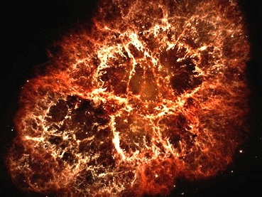

Slide 2
Advanced LIGO
Improvements
(and Risk Mitigation)

Slide 3
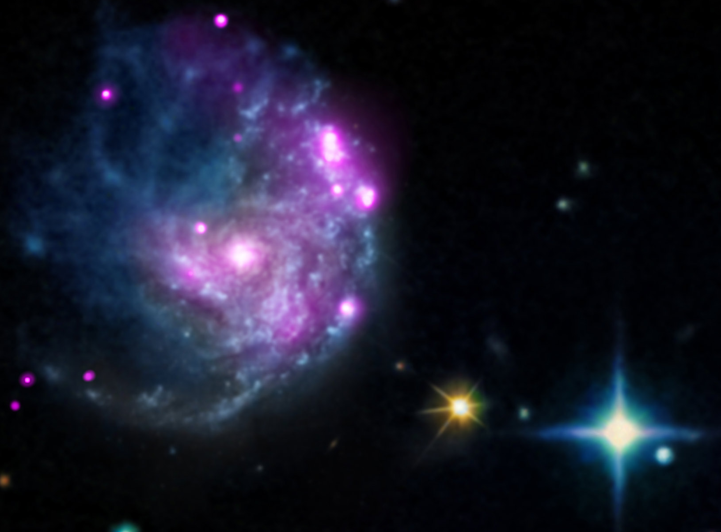
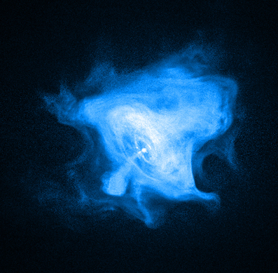
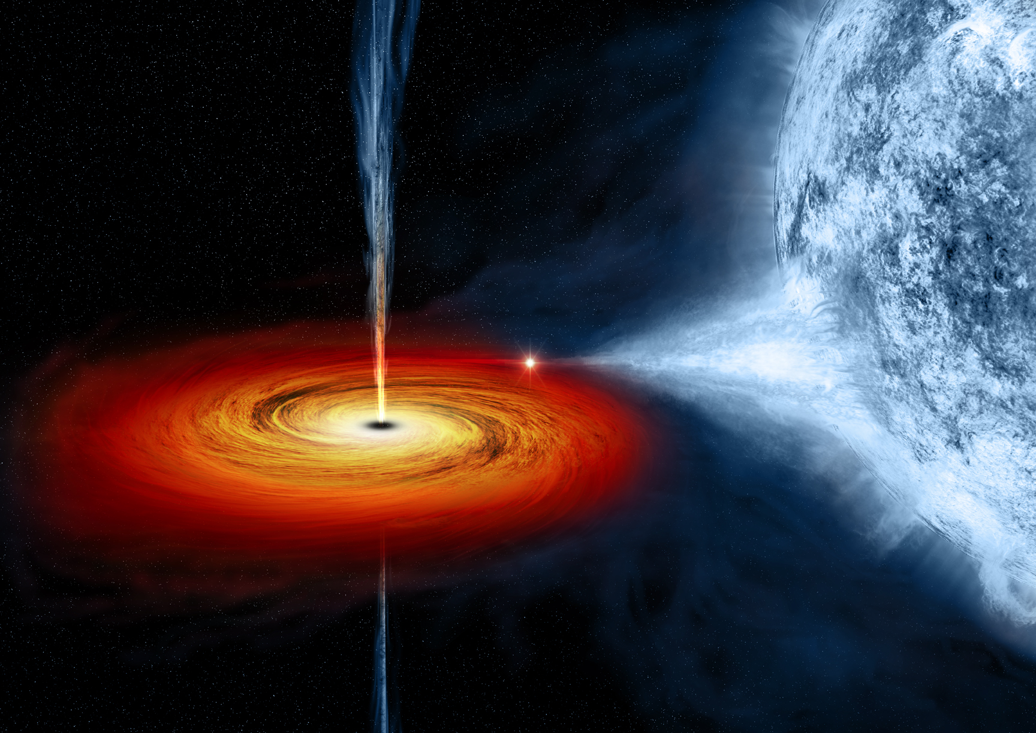
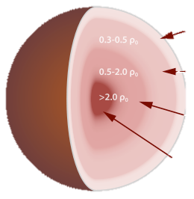
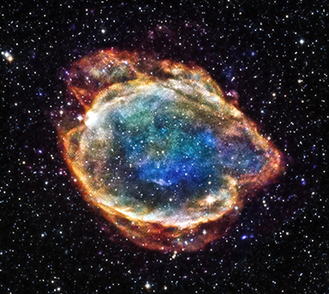
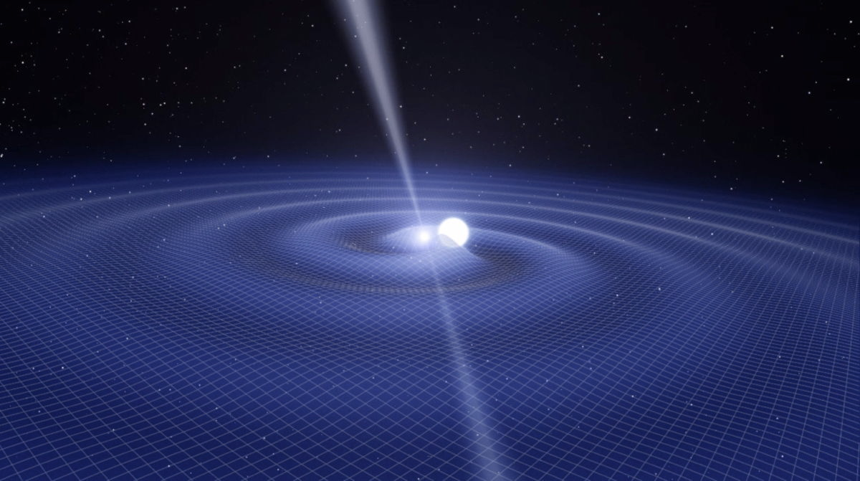
Different sources motivate different improvements
IMBH
Pulsars
LMXB
NS EOS
SN
Binary Populations
Tests of GR
Multi-messenger

Slide 4
Advanced LIGO fundamental noises
technical noises

Slide 5
Overview of possible improvements
Squeezing
  proven technology
  possibly with a filter cavity for low frequencies
Optical detuning to target specific sources
New optics
  better coatings
  heavier masses, better suspensions
Improved readout technique
Newtonian noise cancellation
quantum
newtonian
suspension
coating
technical

Slide 6
Many Improvements also
Serve as Risk Mitigation
High Power Operation Challenges
  thermal effects, parametric instabilities, high loss
  use squeezing to reach design sensitivity
Excess Coating Thermal Noise
  new coating materials
  larger optics
Excess Suspension Noise
  longer suspensions, bigger gaps
quantum
newtonian
suspension
coating
technical

Slide 7
New Designs Offer Flexibility
This is research; things might come up
  we have some known issues to address
    gas damping, roll mode, scattered light, BS too small, …
  we have some potential issues
    crackle noise, contamination driven losses, scattered light, technical noise couplings…
  and then there are the surprises…
It is good to have options
  better suspensions
  balanced homodyne readout
quantum
newtonian
suspension
coating
technical

Slide 8
Agenda
Lisa Barsotti
Focus on high-frequency sources
Stefan Ballmer
Targeting mid-frequency sources
Rana Adhikari
What can be done for low-frequency sources

Slide 9
Limitations
We are limiting this discussion to short term
  but we are thinking long term
    all of these upgrades play a role in improving next generation detectors
Time and cost estimates are rough
  within a factor of 2-3 in most cases

Slide 10
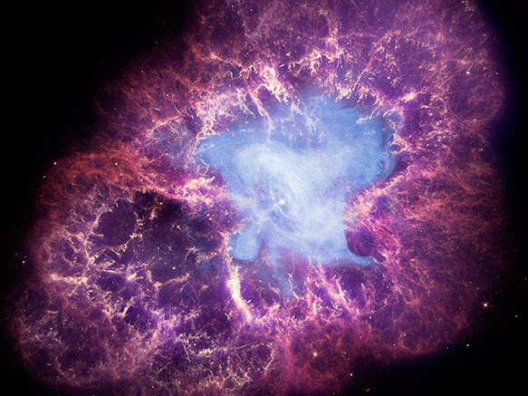
X-ray: NASA/CXC/SAO/F.Seward
Optical: NASA/ESA/ASU/J.Hester & A.Loll
Infrared: NASA/JPL-Caltech/Univ. Minn./R.Gehrz

