Slide 1
Dawn of GW Astrophysics:
Multi-messenger Astronomy
Jonah Kanner LIGO Lab - Caltech
LIGO-G1500579-v6

Slide 2
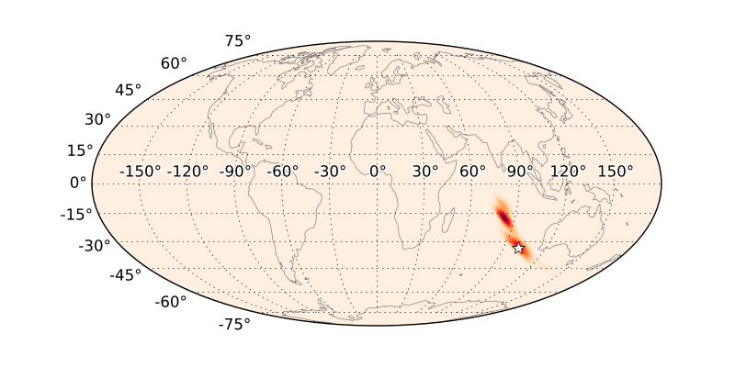
First 5 years: 2018-2023
LIGO + Virgo + Kagra + LIGO India
3, 4, or 5 detector network!
BNS Range to ~200 Mpc
Several to 10’s of detections per year
Localizations of 10’s to 100’s of sq. deg.
or better!
Red-shift measurements for CBC sources
Singer et al 2014

Slide 3
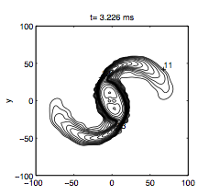
What is the origin of heavy elements?
Abundances of heavy elements (A > 90) not described by stellar processes or SN
NS-NS / BH-NS merger seem good candidates – observable as kilonova (~week long EM transient)
Observing kilonovae could help understand origin of matter!
Rosswog et al. 1999

Slide 4
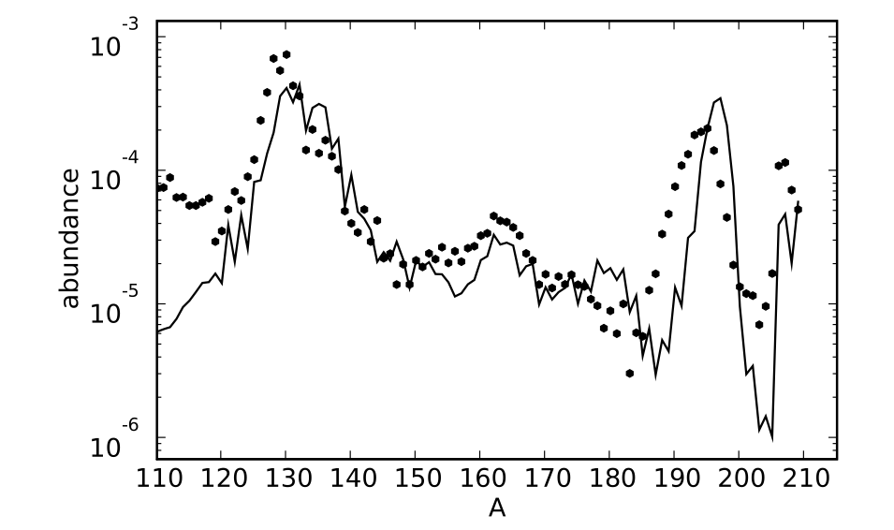
Metzger et al. 2010
Mass Number (A)
The RELATIVE abundances predicted from NS-NS mergers fits the observed distribution…

Slide 5
Metzger et al. 2010
?
Mass Number (A)
But the RATE of production is uncertain by 3 orders of magnitude!

Slide 6
Quantify rate of heavy element production
Uncertainties in model include:
Rate of compact object mergers
Measured population of LIGO events
Amount of ejecta from each merger
Probed by luminosity and time-scale of Kilonova
BH-NS, NS-NS, or both ?
Measured by GW parameter estimation
Kilonova + GW observations will provide a strong test of this model

Slide 7
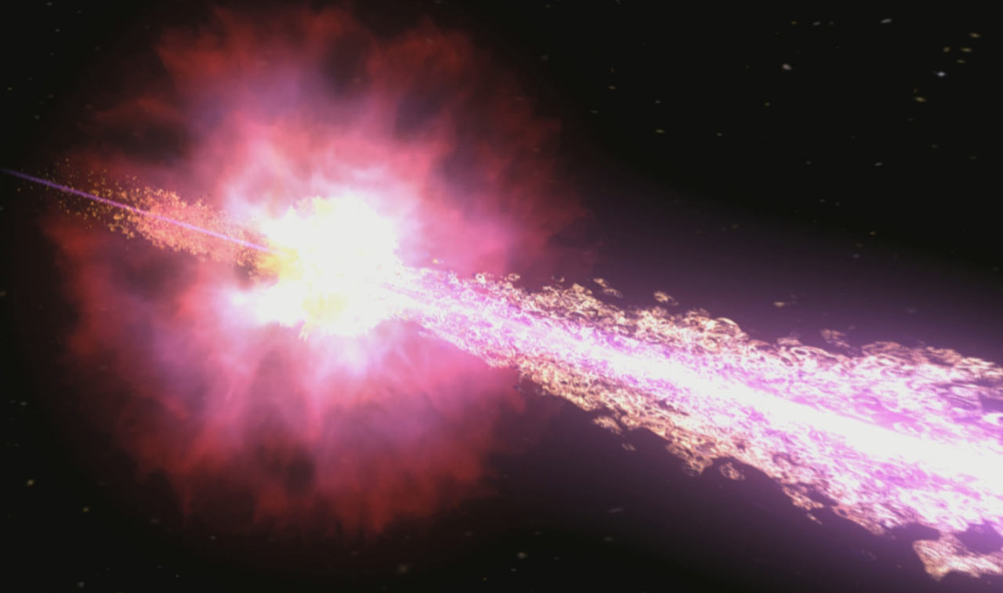
Coincident GRBs
~2% of NS-NS mergers will have coincident GRB
Could see one or a few in the first few years
Never measured a GRB red-shift within LIGO/Virgo horizon
Making this connection will probe many science questions
Sources of short GRBs
Beaming angles
Source population
Relationship to host galaxy
Mass distribution
NS-NS or BH-NS
Clues to jet structure / formation
Timing between GW and GRB will give clues to source physics, maybe equation of state
Image credit: NASA / Swift / Cruz deWilde.

Slide 8
Neutron Star Equation of State
High SNR mergers are key
Many possible ways to probe this:
Tidal deformation perturbs GW phase
Remnant NS post-merger signal peak frequency
Amount of mass ejected in Kilonova
Measure ejected mass through luminosity/timing
Relative timing of GW and GRB signal (?)
Existence of GRBs for NS-BH systems
h(t)

Slide 9
Enabling the Science

Slide 10
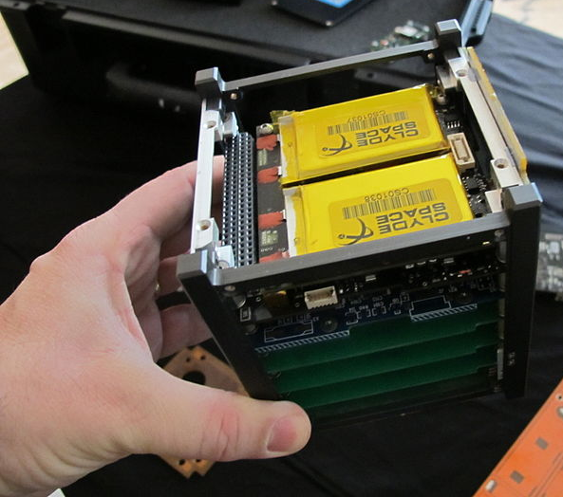
GRB all-sky coverage: CubeSats
Current GRB observatories (Fermi, Swift) may not last through this era
Space agencies will probably continue observing GRBs
Many proposed missions
SVOM scheduled for 2021
CubeSats could fill a potential gap
All-sky GRB monitoring … in a box!
Low cost point
Proposal in progress from Goddard
PI: Jeremy Perkins

Slide 11
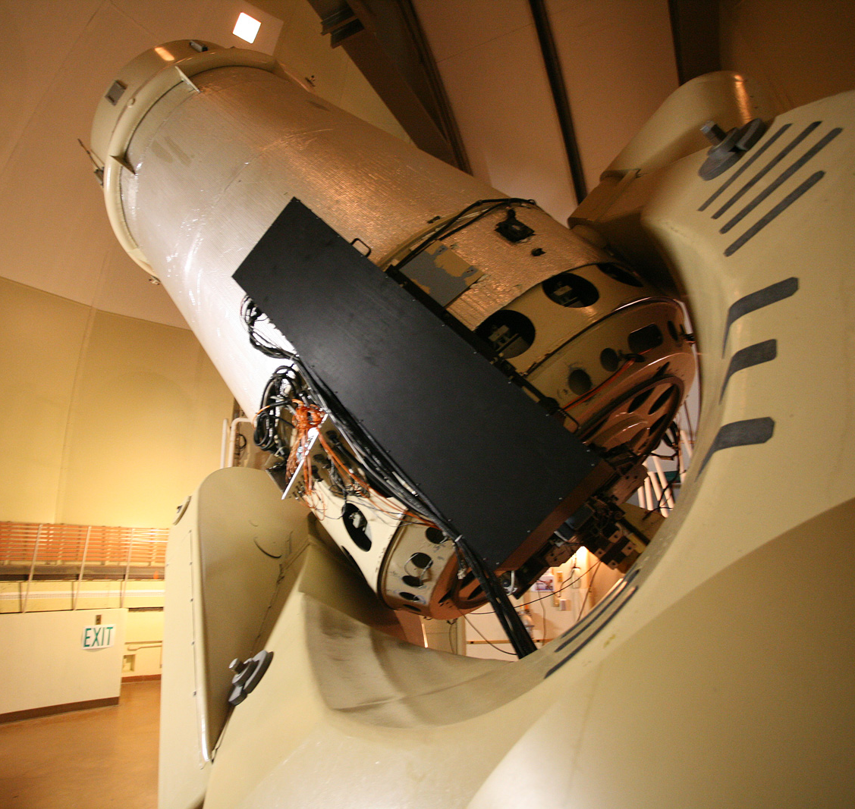
Data Mining and Follow-up for big surveys
Finding a kilonova demands survey in the red or infrared
Modern/Future surveys should be capable
Pan-STARRS, ZTF, DES, LSST …
Data rates will be … big
20 TB per night (LSST)
400 GB per night (DES)
False positives will be a major issue
May be an opportunity to provide specialized computing hardware/software for GW counterparts
May need resources for kilonova candidate validation and photometric follow-up
People, telescopes, and/or computers may all be needed
Build/re-purpose a dedicated, ~2 m follow-up instrument?
Palomar 60 inch

Slide 12
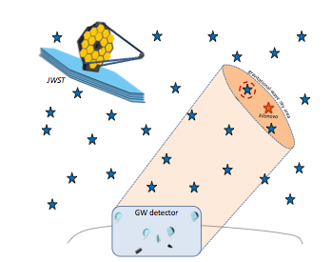
Collect / Curate / Validate Galaxy Catalog
Some facilities may depend on a galaxy catalog to find LIGO counterparts
Swift, JWST (?), …
A validated, public catalog enables:
Enhanced LIGO data products
Small FOV instruments to seek candidates
A range of studies
Work on this already in progress (e.g. Kasliwal), but extra resources needed to collect, validate, and curate a catalog
Bartos et. al. 2015

Slide 13
More Events -> More science
EM counterpart rate will be a fraction of LIGO BNS rate
Coincident GRBs will be ~2% of LIGO BNS rate
As a guess, observed Kilonovae will be ~10% of LIGO BNS
Small number of observed EM counterparts: < 10 per year
30% gain in LIGO BNS range would double this!
A small change in LIGO sensitivity makes a big difference
Probably means improving low frequency (20-300 Hz) sensitivity
FOM: BNS Range

Slide 14
Match GW sensitivity across network
Search area very sensitive to number of equally sensitive detectors in network
2 IFO -> ~400 sq deg
3 IFO -> ~100 sq deg
4 IFO -> ~10 sq deg
Improving poorest performing detector may be best “bang-for-buck” for multi-messenger astronomy if detections are common-place
If detections are very few, may be better to improve 2 most sensitive detectors to improve rates

Slide 15
SNR at the merger
High SNR events help with big questions
NS equation of state, parameter estimation, tests of GR
Small gains in sensitivity could make a big impact
SNR 20 is a lot better than SNR 12
Lots of interesting science at moment of merger
Tidal stretching, NS resonant frequencies, extreme gravity
Key for position reconstruction
Points to improvements at LIGO high frequency
1-3 kHz range
May also be a key range for galactic events, if we find them!

Slide 16
Summary
Improving the GW network benefits multi-messenger astronomy
Improve BNS range for more sources
Match sensitivity across network for localization
Improve high freq. noise for more SNR at merger
Could try to patch “holes” in EM landscape
CubeSats to monitor for GRBs
Follow-up / Data Mining for large NIR surveys
Validate / Curate galaxy catalog

Slide 17
Thank you!

Slide 18
Extra slides

Slide 19
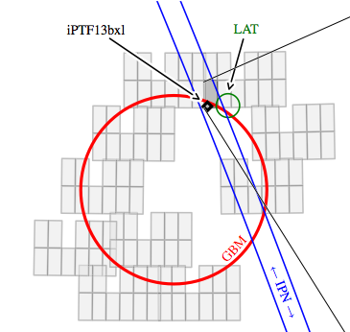
The follow-up bottleneck
“Inspection” by graduate student:
7 candidates
70 sq deg survery: 27,000 variable objects
Pass automated cuts:
43 Candidates
“Narrow Field” follow-up:
1 Counterpart + light curve + photometry
Numbers from Singer et. al. 2013

Slide 20
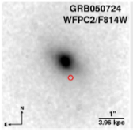
Host Galaxies
Imagine we find some EM+GW signals:
Can localize sources in host galaxy:
What types of galaxies host mergers? Does this depend on mass/spin parameters?
Tells if binaries trace star formation
Is the merger in an area of active star formation?
What type of host galaxy?
Distinguish NS-NS and NS-BH, which we can’t for SGRBs
Is the merger well outside the galaxy?
Probes time until merger
Constrain population synthesis
Learn about strengths of kicks from SN – probes SN physics
Fong, Berger, & Fox 2010

Slide 21
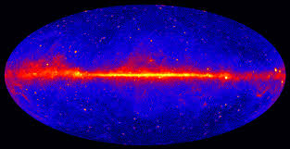
Possible Surprise: Galactic Sources?
All EM bands are dominated by galactic sources
Maybe GW will be too?
Pulsars, R-modes, neutron star hyper flares …
Much of this would be at high frequencies
NS resonant frequencies around ~1-3 kHz
Supernovae have GW content up to ~3kHz
The Fermi LAT sky

Slide 22
Radio Pulses / FRBs ?
A variety of models suggest radio emission from NS-NS mergers
There may be a coherent pulse near the time of merger
May be a fraction of Fast Radio Bursts (“Lorimer” Bursts)
Wide field radio arrays may find these in coincidence with GW signal
Help understand “coherent” emission
Exciting new field of wide field radio astronomy
Early sky position may help!
LWA

Slide 23
Metzger et al. 2010
Mass Number (A)
Model based on NS-NS ejecta (solid)
Measured Solar system abundance (dots)
Overall scale of model is normalized to fit observations

Slide 24
The Loudest GW Event
~40 events at SNR 8 (250 Mpc)
→ 1 event at SNR 27 (70 Mpc)
Easy to find counterpart
Few possible hosts
Bright! Long lived!
High SNR signal gives many details
Better estimate of masses, spins, etc
Measure NS Equation of State!
Test General Relativity!
High resolution image of host galaxy

Slide 25
Some other possible astrophysics targets
Supernovae,
Neutrino alerts,
IMBH,
measuring the Hubble parameter,
Dark Matter halos,
SGRs
Etc …

