Slide 1
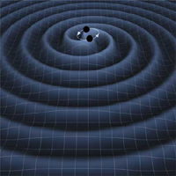
Neutron Star Upper Mass Limits from GRBs and GWs
M. Coleman Miller
University of Maryland
Lawrence, Tervala, Bedaque, Miller arXiv:1505.00231

Slide 2
The Idea
C. Fryer et al. arXiv:1504.07605
S. Lawrence et al. arXiv:1505.00231
Short GRBs are thought to be from NS-NS or NS-BH mergers If NS-BH, LIGO rates go up!
If NS-NS, need rapid collapse, or ν-driven wind will load the jet with baryons and lengthen burst
Thus NS+NS mass must exceed maximum for rotating star (we assume uniformly rotating)
This also places an upper limit on the mass of a slowly rotating star (both depend on EOS) Maximize using parameterized eqns of state
More precise if masses determined from GWs

Slide 3
Example Results
Assume remnant rotates at mass-shedding limit
M_{ch} alone gives good M_{tot} estimate
Lowest M_{ch} that we see will place strongest limit
Adapted from Lawrence et al. (2015)

Slide 4
Useful Future Work
Instrumental High-freq sensitivity! E.g., squeezed light Get both masses independently
Theoretical EM signature of collapse seen more broadly that GRB? Increase coincidences Argument that collapse happens during differential rot? (Margalit et al., in prep) Direct GW signature of collapse?

Slide 5
